Slide 1
Singapore Rainfall Dashboard
Technical Assessment
Name: Quek Jia Hao

Slide 2
Architecture Overview
Diagram of the architecture:
The solution architecture consists of the following key components:
API Source: Real-time rainfall data from data.gov.sg
Data Processing (ETL): Python script to extract, enrich, and store data
Data Storage:
AWS S3: Stores data in Parquet format partitioned by date
AWS Redshift: Data warehouse for querying and dashboarding
Orchestration: Apache Airflow (run in standalone mode locally) to schedule ETL jobs every 5 minutes
Visualization: Metabase (running in Docker) connected to Redshift for dashboarding
This modular and scalable architecture ensures the separation of concerns and future extensibility.
API
Python
(ETL)
AWS S3 (Parquet, partitioned)
AWS Redshift
Metabase (Docker)

Slide 3
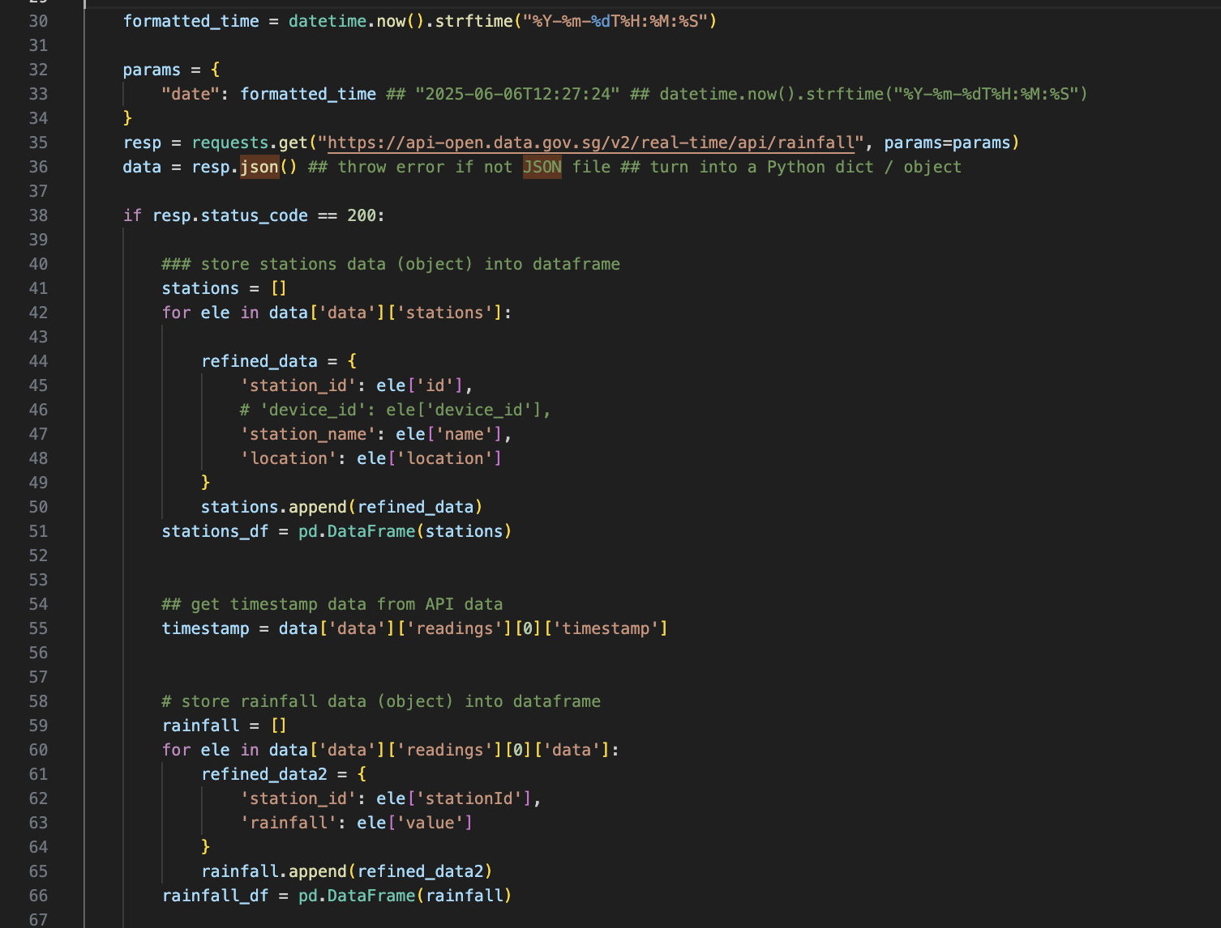
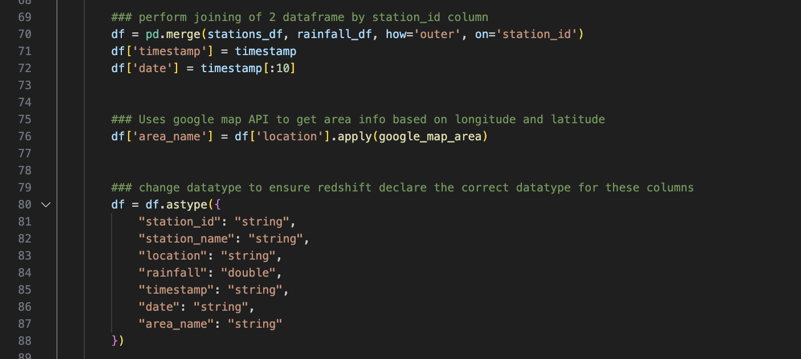
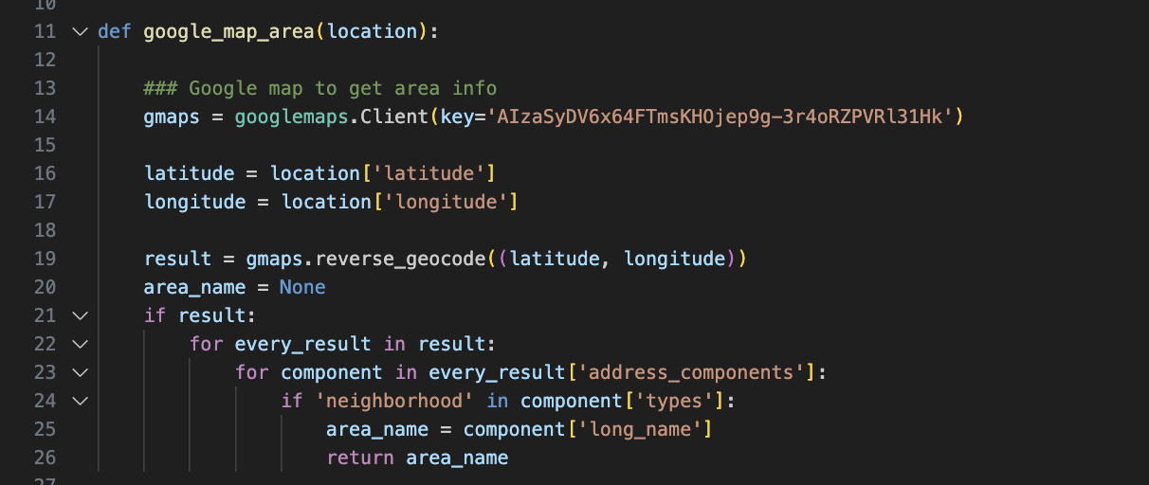
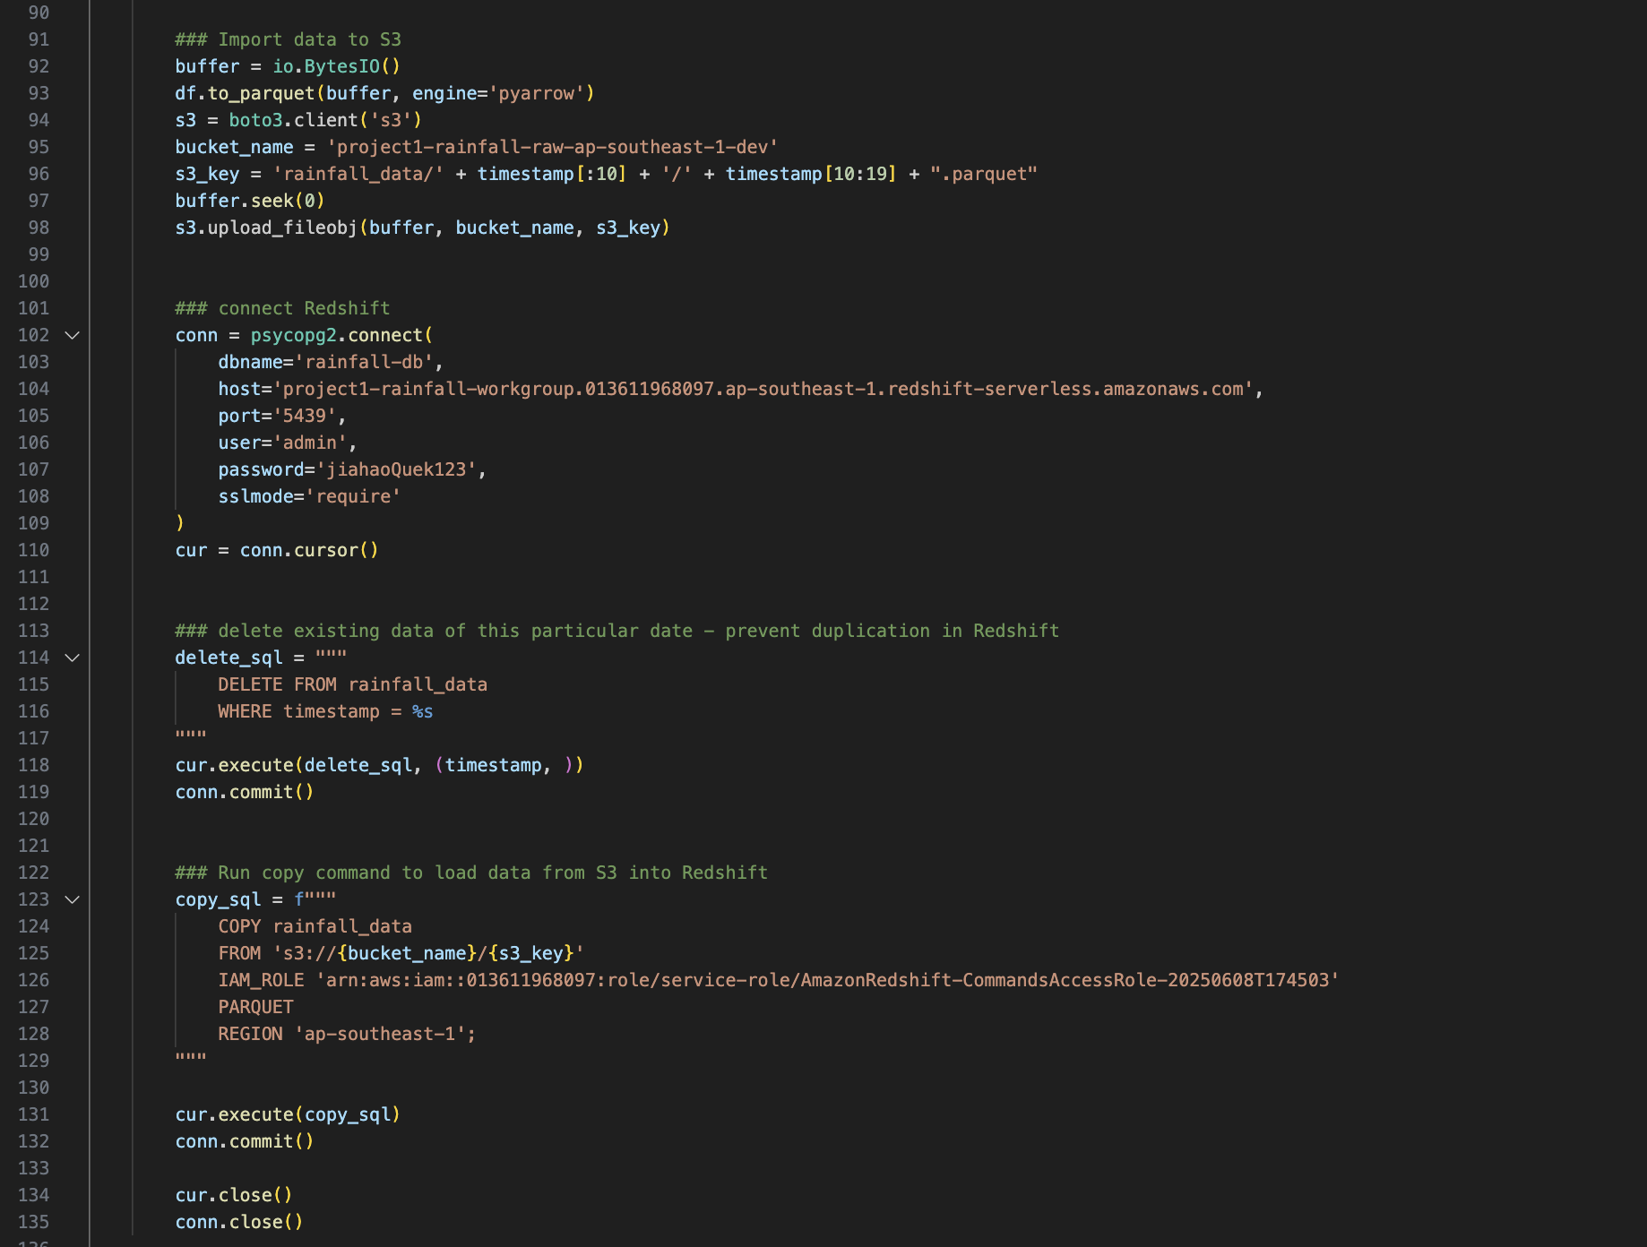
ETL Pipeline
The ETL (Extract, Transform, Load) process is built using Python. Here's a breakdown of the steps:
Extract:
Rainfall data is pulled from the public API using the current timestamp. The data includes rainfall values and station metadata.
Transform:
Merge station data with rainfall data on station_id
Use Google Maps API to derive area_name from geographical coordinates
Add timestamp and date for time-based partitioning
Standardize data types to match Redshift schema
Load:
Data is stored in S3 as a Parquet file with folder paths based on date (partitioned by date)
Redshift COPY command is used to load data from S3 into the rainfall_data table
This process enables efficient querying and scalable storage.

Slide 4
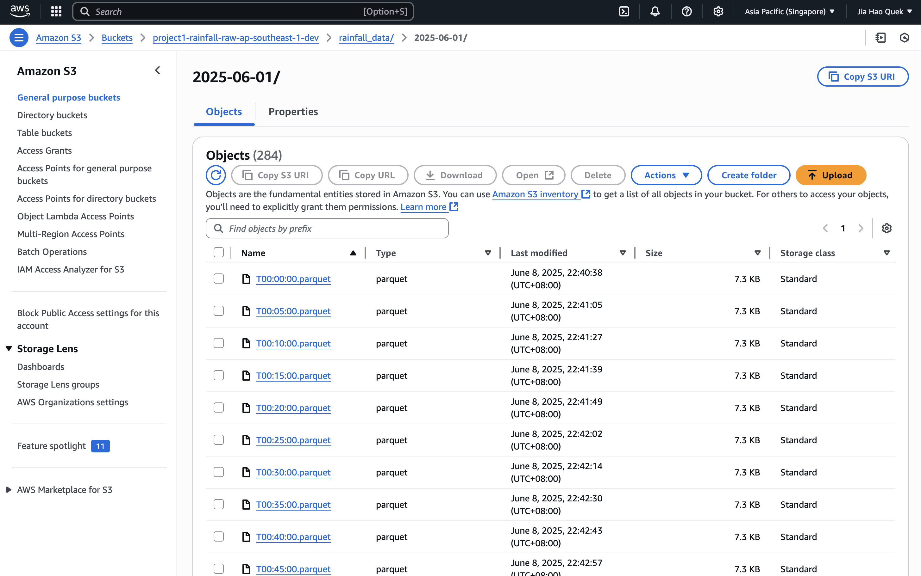
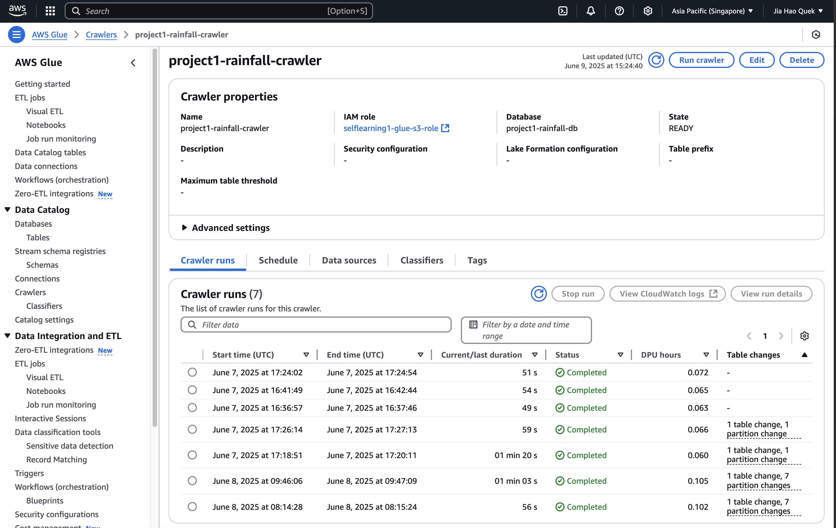
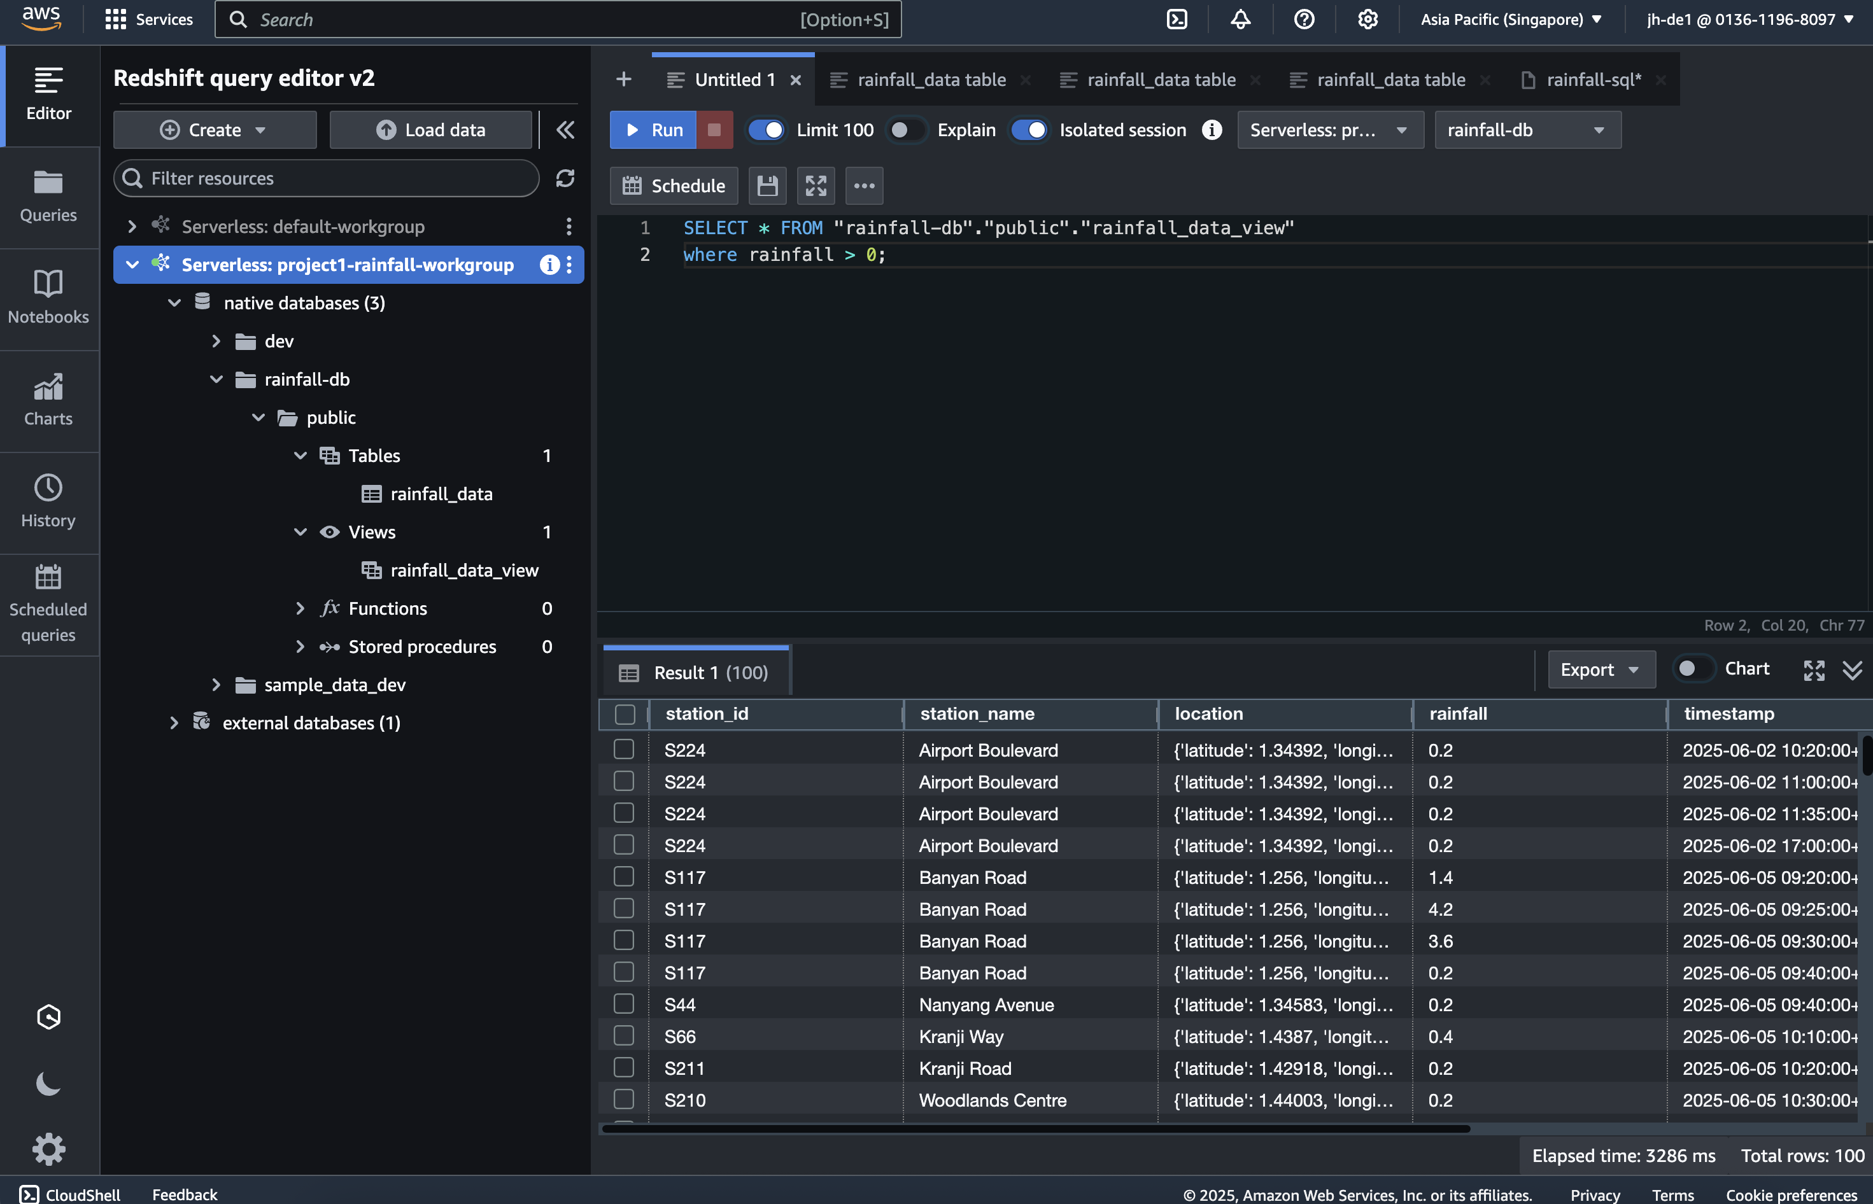
AWS S3
Data Storage Strategy
Although the dataset is relatively small, the use of S3 and Parquet format is a forward-looking design choice for scalability:
Parquet Format: Columnar storage reduces I/O and improves performance for analytical queries
Partitioning: Data is stored in date-based folders which allows selective loading and reduces scan time
AWS S3: Durable and cost-effective object storage
Redshift: Centralized data warehouse that supports SQL querying and BI integration
These design decisions align with data engineering best practices and facilitate growth.
AWS Crawler
AWS Redshift

Slide 5
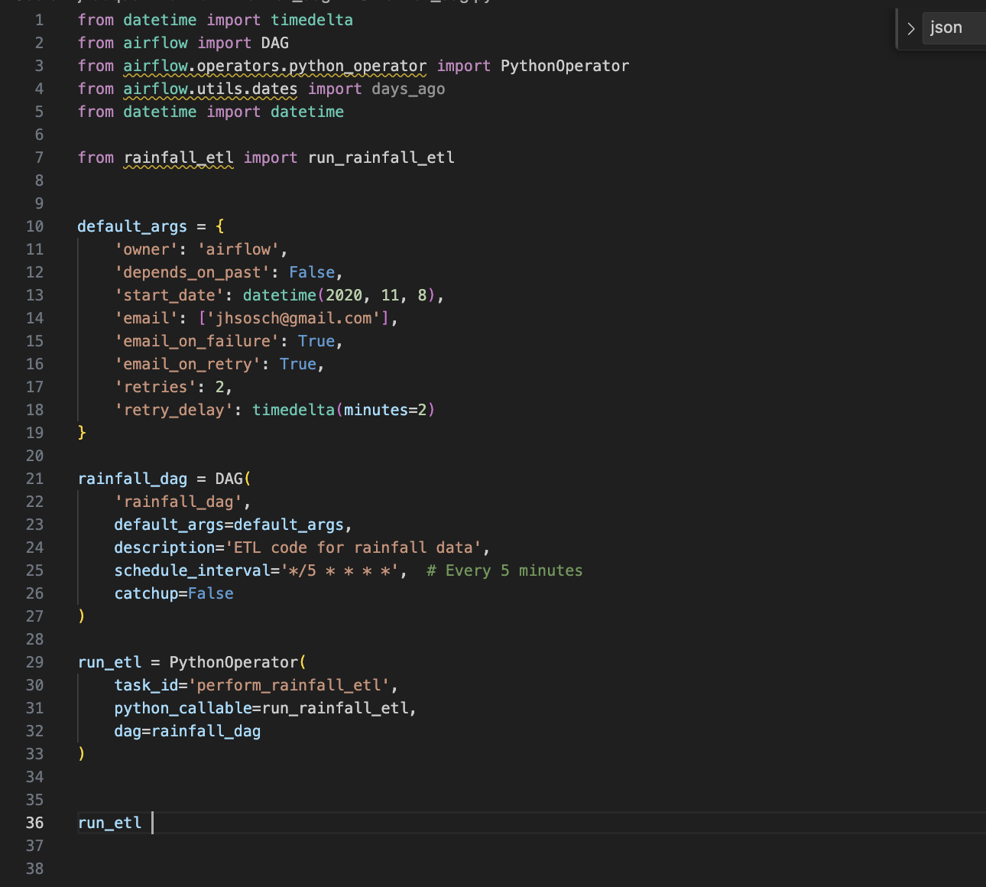
Airflow Orchestration
Apache Airflow is used to schedule the ETL process. The DAG is defined to run every 5 minutes to simulate near real-time data updates:
Task: run_rainfall_etl invokes the ETL Python script
Environment: Airflow is run in standalone mode locally
Using Airflow promotes maintainability, observability, and flexibility in managing workflow dependencies.

Slide 6
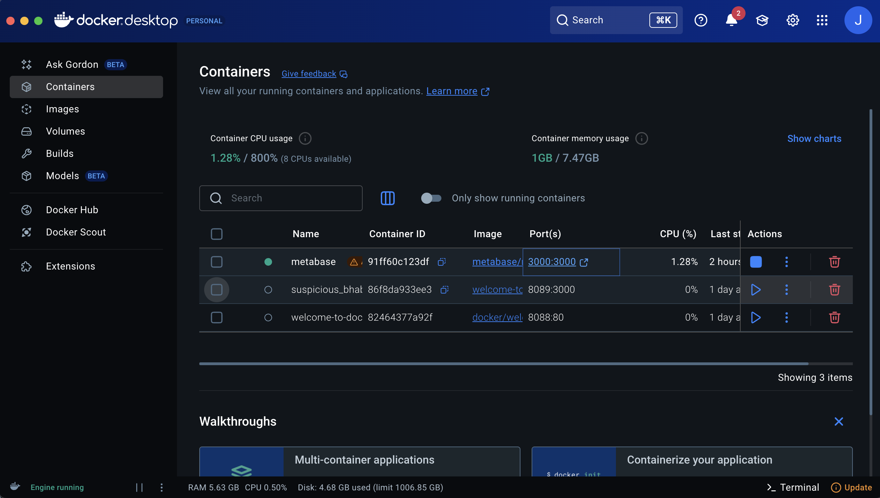
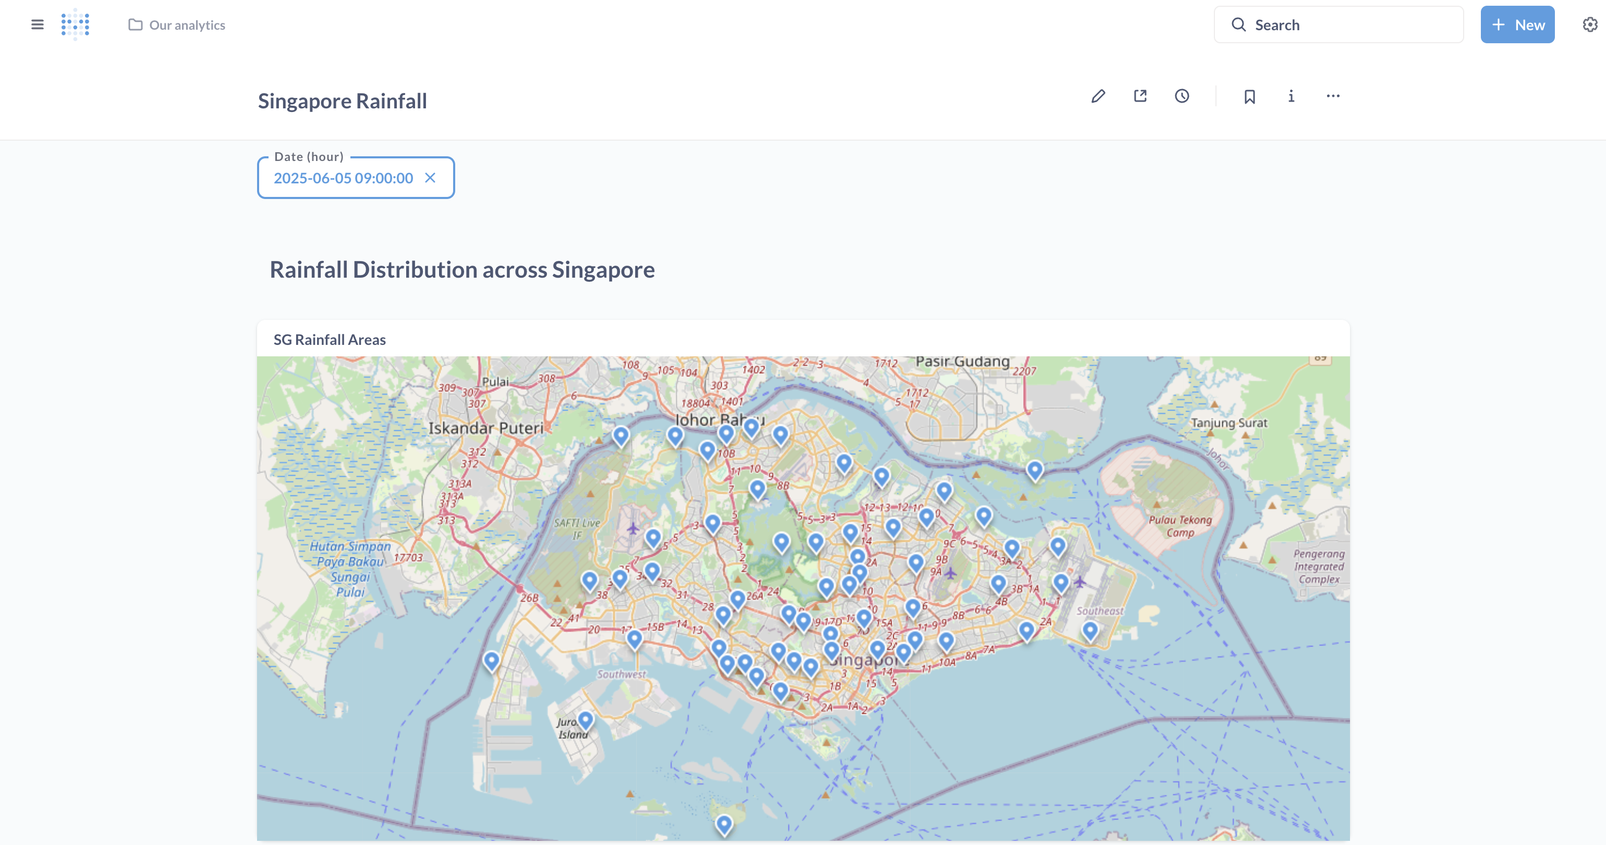
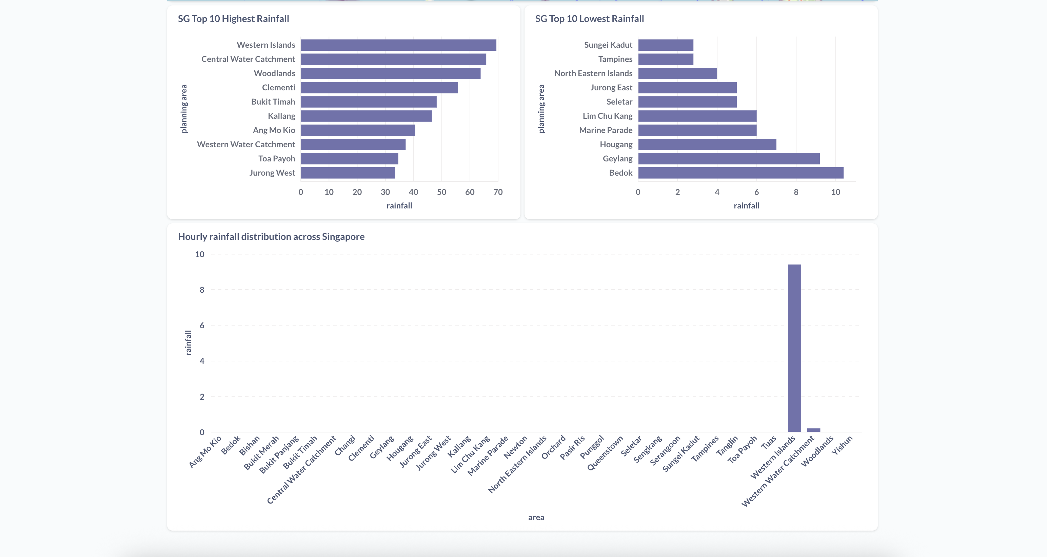
Data Visualization with Metabase (Docker)
Metabase was deployed locally via Docker and connected to Redshift for BI reporting. Four main charts were developed:
Rainfall Map with Pins: Displays rainfall intensity and location on a map using latitude/longitude.
Top 10 Areas by Rainfall
Lowest 10 Areas by Rainfall
Hourly Rainfall Distribution with Filter: Allows users to select a specific hour from a dropdown and view rainfall distribution.
* I chose to use Metabase for this project because Tableau’s free version does not support connections to cloud databases like AWS Redshift.

Slide 7
Alerting Strategy
While not fully implemented due to AWS resource limitations, the alerting mechanism is designed to:
Compare current readings against monthly average rainfall.
Trigger notifications (e.g., email or SNS alert) when threshold is breached.
An alternative way to implement the alert mechanism is by enhancing the existing Python ETL script that runs in Airflow. Each time new data is ingested, the script can immediately compare the latest rainfall value against the monthly average and trigger an alert if it exceeds the threshold.
This can be further improved using tools like AWS SNS (Simple Notification Service) or Slack API to send real-time notifications.

Slide 8
Challenges and Decisions
AWS Free Tier Limits:
EC2 resources insufficient for full deployment.
Metabase and Airflow run locally as a workaround.
Data Volumes:
API returns small volumes, but architecture allows for scale.
The API from data.gov.sg stopped providing new data after 8th June 2025 due to maintenance. Therefore, to simulate and demonstrate the dashboard functionality, I used historical data from the days before the outage.
Google Maps API Cost:
Reverse geocoding adds cost; caching strategies recommended for scale.

Slide 9
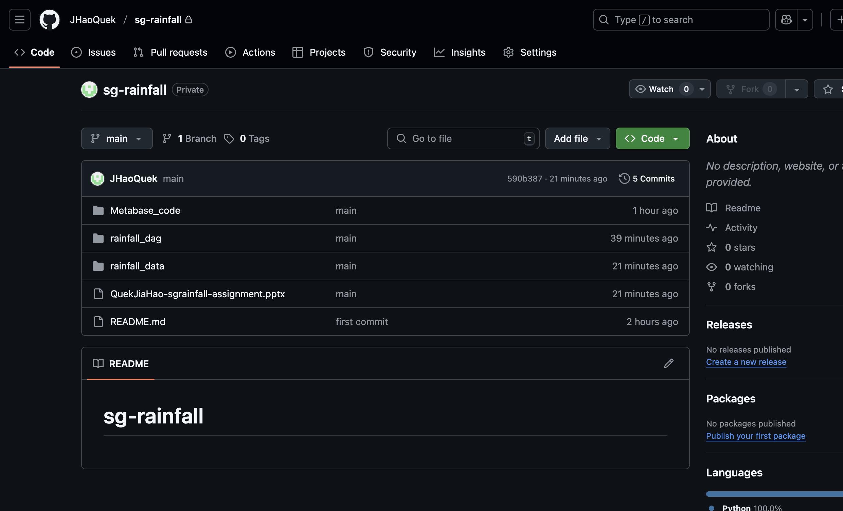
GitHub and Deployment Notes
Code is stored in a GitHub repository (made private for assessment).
I have pushed the following materials to the GitHub repository:
The complete Python code for the ETL pipeline, including API extraction, S3 upload, and Redshift loading
SQL queries used in Metabase to generate all four visualizations
Sample rainfall data retrieved from the API before June 8th, used to simulate the dashboard and testing
Please let me know your GitHub username so I can grant access to the private repo: https://github.com/JHaoQuek/sg-rainfall.git

Slide 10
Conclusion
This project demonstrates the practical implementation of a scalable data ingestion and analytics pipeline using Python, AWS services, and Docker-based tools.
Modular, production-oriented code
Resilient cloud storage and compute architecture
Realtime analytics and visualization
Future enhancements:
Full deployment on AWS
Automated alerting and Slack/email integration
Dashboard sharing via hosted Metabase instance

Slide 11
Thank you!
Name: Quek Jia Hao

